Slide 1

“Hitchhiker” systems
Duncan Jones
💬 @Merrion
Distributed computing for pennies
Notes:
Good morning and thank you very much.
My name is Duncan Jones and my twitter handle (probably the easiest way to contract me) is @Merrion

Slide 2
Agenda
Sources of cost
Introduction to “event sourcing”
Introduction to Azure storage and Azure Event Grid
Overview of a proposed system architecture
Lessons learned
Notes:
First I need to discuss where cost comes from, in the context of cloud computing.
Then briefly explain event sourcing because the solution I have put together makes extensive use of this (and I will explain why at the same time)
Then the environment in which this is to be hosted – using the Azure Event Grid, Durable Serverless functions and Azure storage.
Then I will walk through the way the architecture hangs together
Finally I’ll wrap up with lessons learned and Q&A

Slide 3


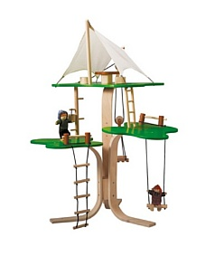
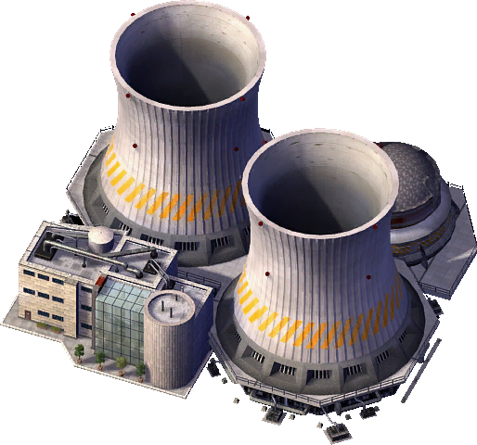
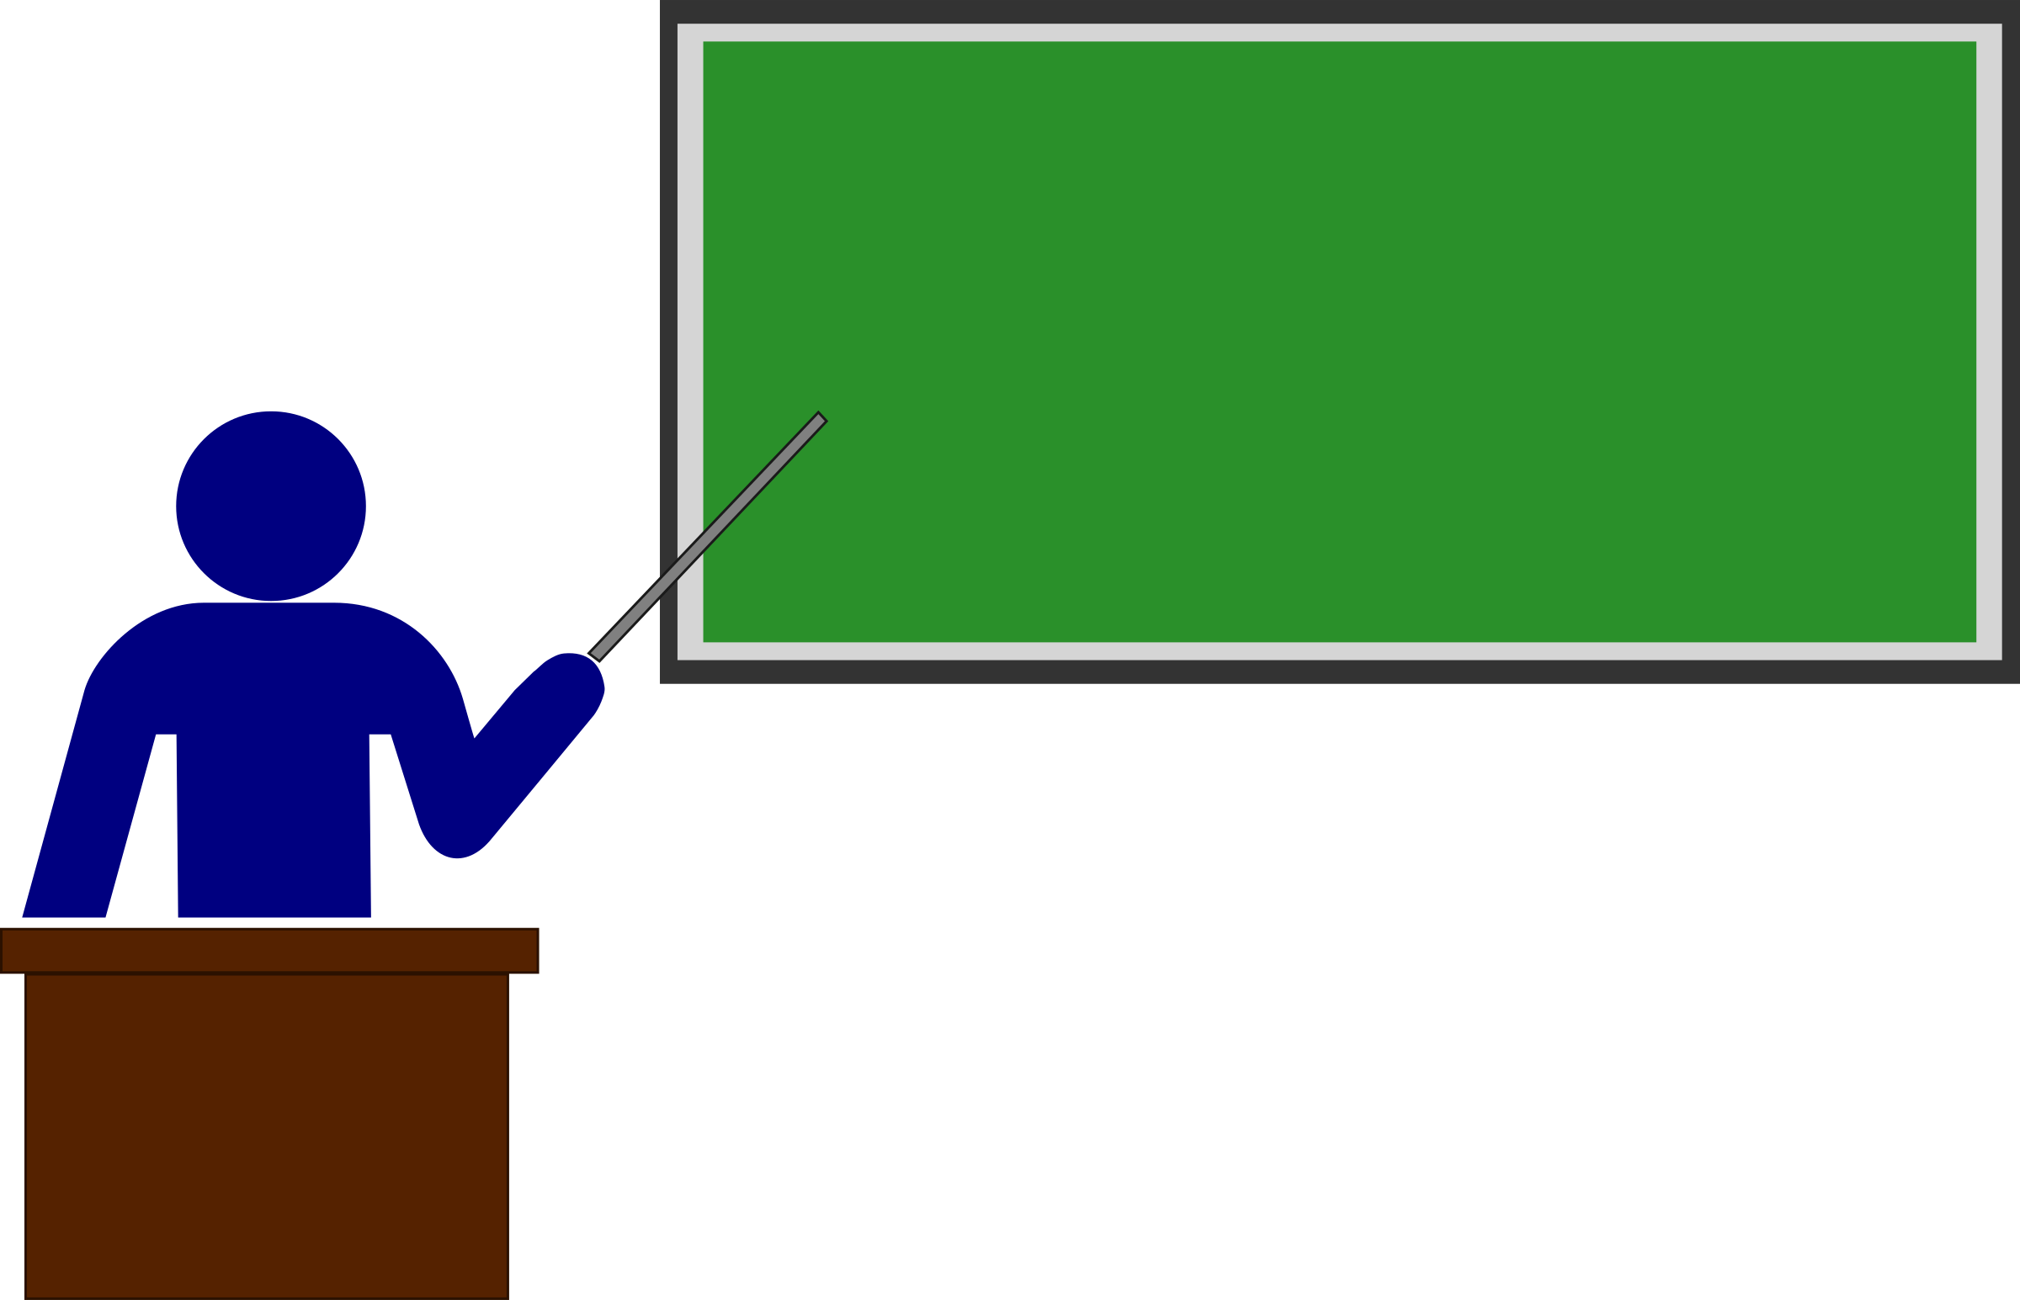

Caveats
Notes:
The system I am describing here is best suited to non critical or occasional/burst use scenarios rather than enterprise critical systems and is tuned toward minimising cost rather than maximised performance.
It is also an experiment rather than a definitive textbook example.
To manage expectations, what I am looking for is an equivalent to what Blogs did for micropublishing in applications.

Slide 4
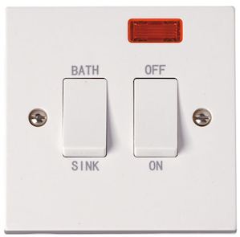
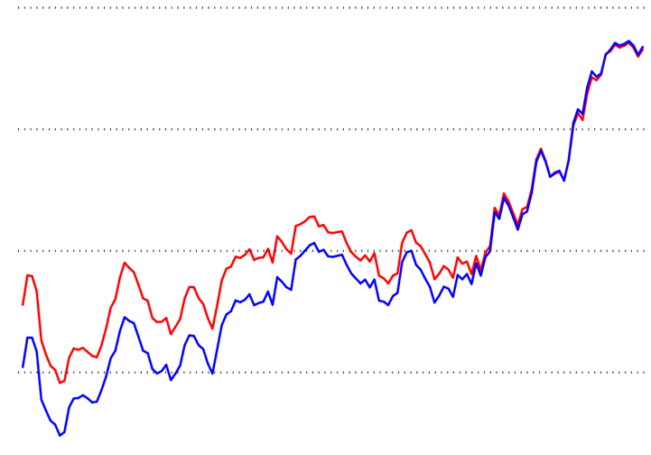
Sources of cost
Fixed costs
Overprovisioning
Notes:
There are two main sources of cost that we need to address with regard to cloud hosted systems:
The first is always-on systems, for example virtual machines, for which a cost arises regardless of use.
The second is overprovisioning, where we have to reserve more processing power than we are using so that we are able to ramp-up to match rapidly increasing demand.
Azure serverless functions address these two sources of cost “out of the box”

Slide 5
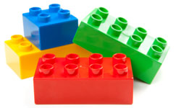
Introduction to “event sourcing”
Opened
Account
Deposited Money
Withdrew Money
Closed Account
Margaret
00002
$10.00
$10.00
Event Type | Action
Opened Account | Skip
Deposited Money | Increase balance by $
Withdrew Money | Decrease balance by $
Notes:
Event sourcing is a way of storing data, not as the current state of the entity (as in active state) but rather as a sequential history of all the events that have occurred to an entity.
This history is implemented as an append only event stream. It places the onus on getting “state” onto the system that is reading the data which has to run a projection over the event stream.
This is done by (and is the responsibility of) the process that needs that state, either to report it or to use it in a business decision.
This allows us to eliminate one of the “always on” fixed costs – the state consistency management system (or database to use the more common term).

Slide 6
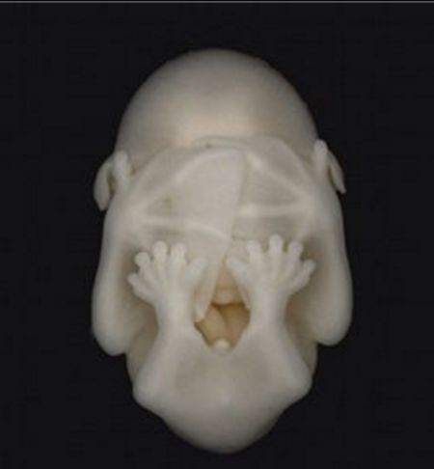
Event sourcing on Azure functions code example

Slide 7
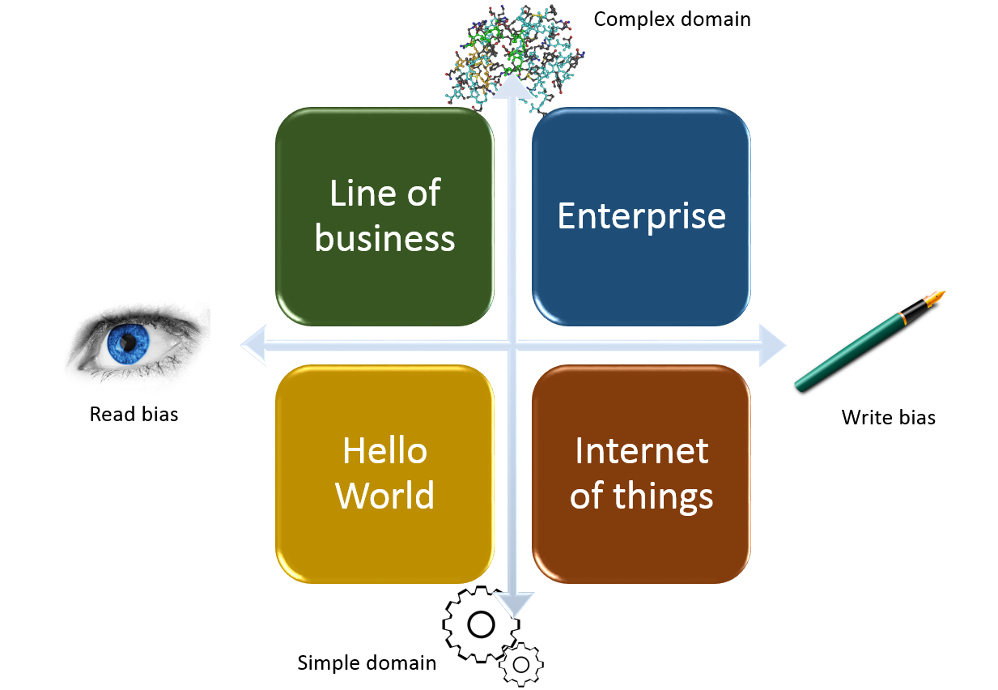
Introduction to Azure Storage
Cosmos Db
Tables
Files
Append Blob
Notes:
For a more complicated system I would recommend using CosmsosDb – much to the relief of our sponsors, no doubt – and there is a talk coming up from Craig Nicol which will address the why and the how of that.
For smaller scale systems there are three other options. For the more read –biased application I would recommend either Azure Table storage or Azure Files – and for a write-biased system I would recommend the Azure AppendBlob storage. This matches very well the “event sourcing” architecture discussed earlier.

Slide 8
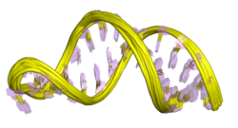
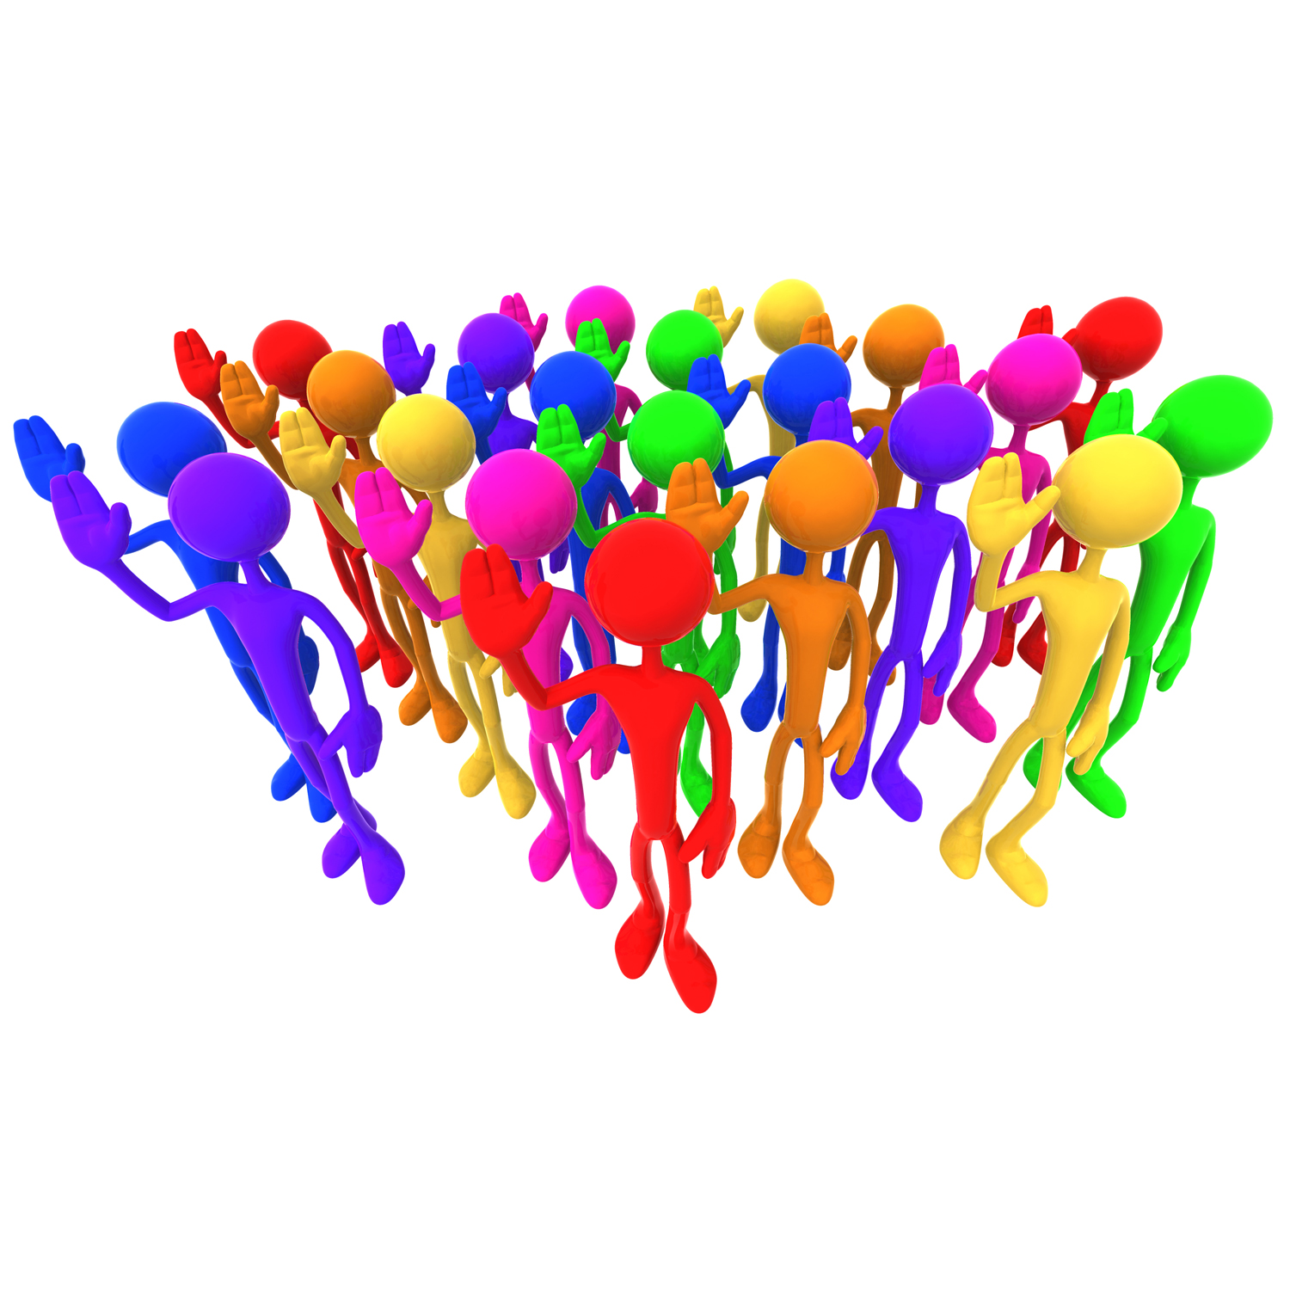
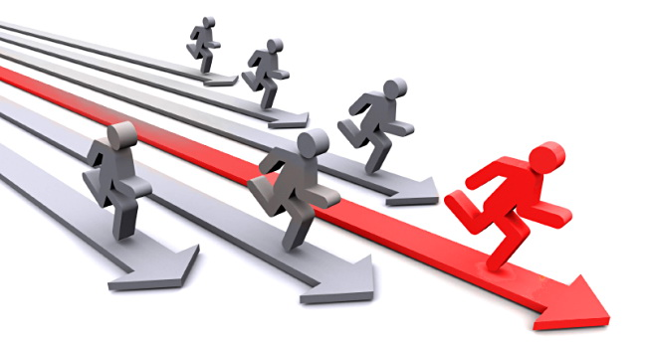

Overview of an example system
League
Race
Query
Command
Runner
Query
Command
Command
Query
Notes:
The demonstration system is for organising an amateur running organisation.
It is split into three domains – the league domain being anything to do with the overall organisation of leagues,
The race domain being to do with an individual race,
The runner domain being relating to the runner and their interaction with the organisation.
Importantly there is no privileged communication between the domains – the interface available to each other is the same interface publicly available outside.

Slide 9
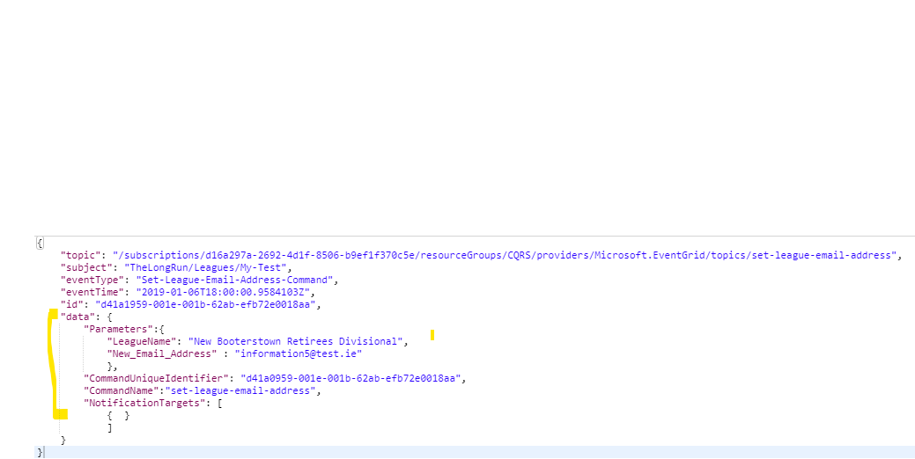



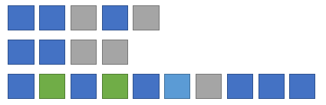
Handling a command
Durable Function Orchestration
Append
Event(s)
Command
Validations
Notes:
A command is issued to the system through an event grid topic.
The parameters required to perform the command as well as any authorisation tokens and externally supplied unique identifier are supplied in the payload to this event grid topic.
When a message is received by the topic it triggers a serverless function to handle the command.
This uses the durable function framework to call activities that perform each step in turn and, if all is OK, appends 1 or more events to the event streams of the entities updated by the command.
As well as the built in durable function orchestration which is backed by a table the command has its own event stream in which the progress is logged.

Slide 10
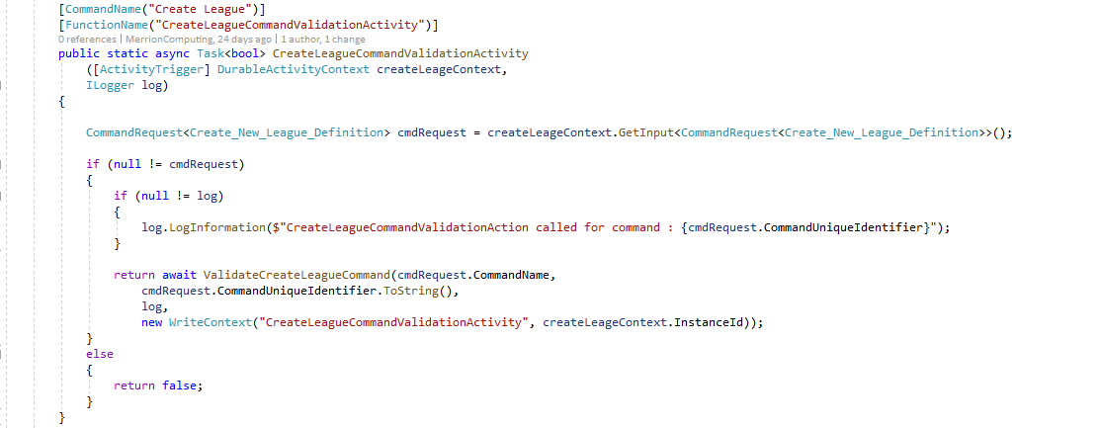
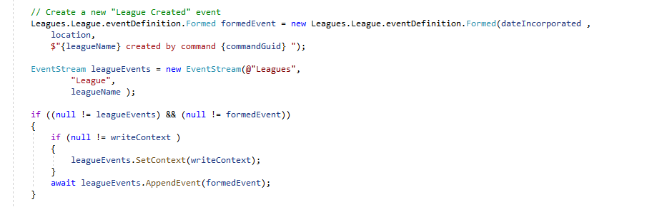
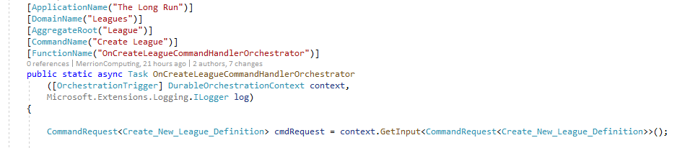
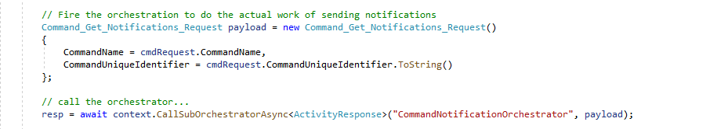
Command orchestrator
Trigger Orchestration
Validate Parameters
Append
Event
Send Notifications
Notes:
The orchestration function has an [OrchestrationTrigger] attribute and durable orchestration through which the details of what kicked off the orchestration can be found
The orchestration calls out to Activity methods which do the actual work of each step
Events are appended to the appropriate EventStream in order to record what the command has done – effectively what has changed
An independent sub orchestration is fired off that does all the work to do with notifying other domains of this command’s action

Slide 11
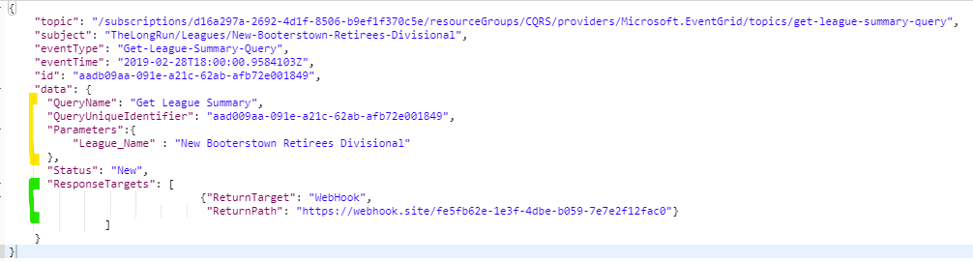
Handling a query
Durable Function Orchestration
Query
Validations
Run
Projection(s)
Return
Results
Notes:
A query is handled in a similar manner but in addition to the parameters you also pass in a return address to which the results of the query should be returned.
This could be, for instance, a webhook or an azure storage location to drop a file into.
This allows the query to be executed asynchronously.
The query runs projections over the event streams of the entities it is getting data for and then performs any aggregation needed over these before returning the results.

Slide 12
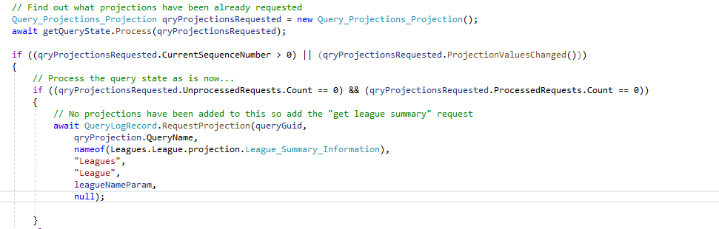
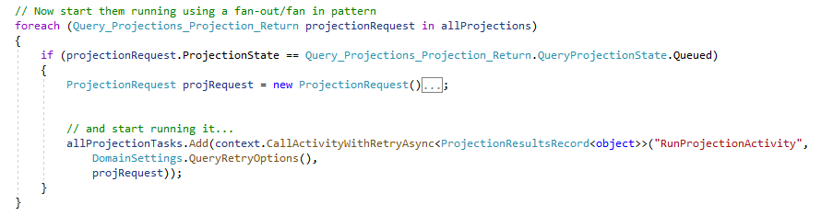
Query orchestrator
Trigger Orchestration
Validate Parameters
Run Projections
Send Results
Request Projections
Notes:
Projection requests are written to the query event stream so we can see what work has been done and what is outstanding in running the query
Projections themselves can then be run in parallel by using durable functions “fan-out” mechanism.
Once all the projections are complete any totting up steps could run.

Slide 13
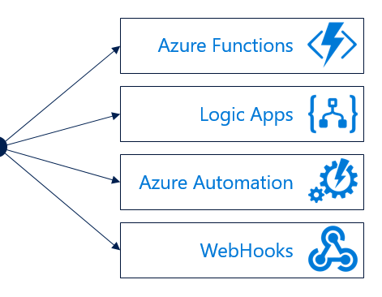
Notifications and inter-domain communication
Notes:
Domains communicate directly with each other by these commands and queries
Domains can also raise notifications that other domains or indeed other processes can subscribe to.
(These notifications are tagged with the “as of date” and “as of sequence number” information so that the subscriber can determine if it has already received this notification before.)

Slide 14
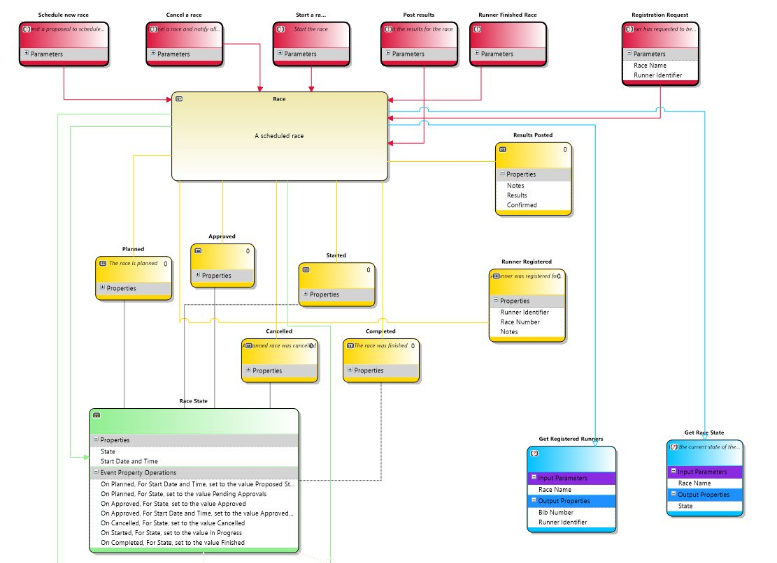
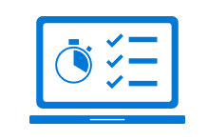
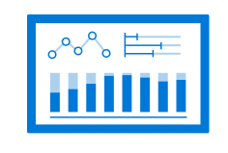
Lessons learned
Don’t assume. Measure!
Read your writes
Invest time in design
Notes:
Because serverless computing is no less susceptible to the “sunk cost fallacy” it is worth investing time in design before getting started coding. It is a mistake to allow the rapid spin-up time of serverless functions as an excuse not to do some design work. I would recommend looking at things like event storming as a way to do this.
If you are dealing with a system that needs to be able to survive being spun down without the worry of data loss requires being rigorous about reading your won writes – i.e. making sure any state change is persisted before it is used.

Slide 15
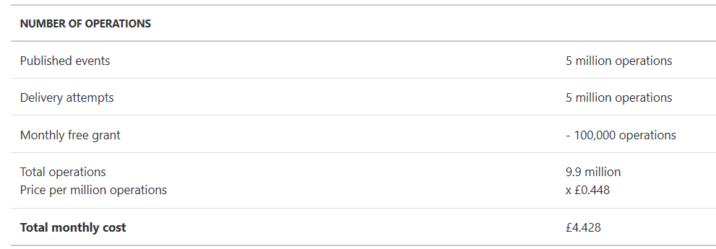
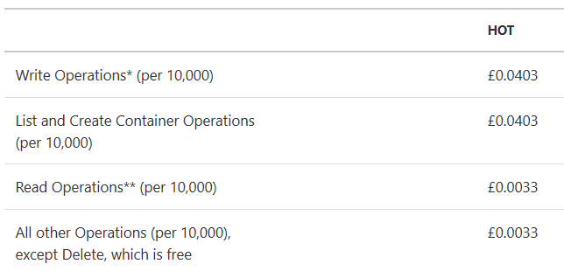
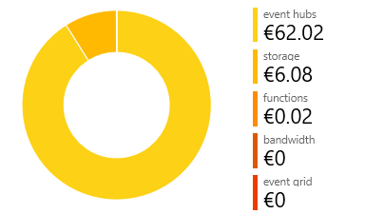
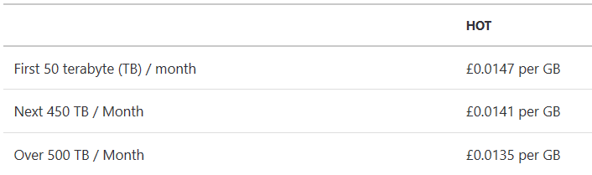
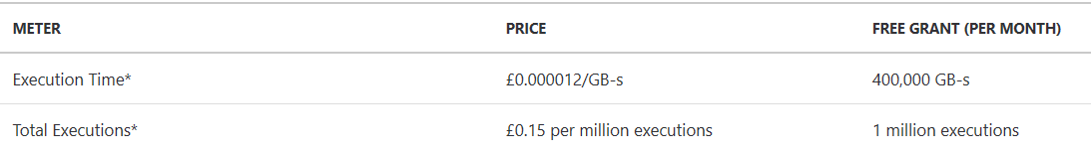
Costs
Event Grid
<£1 / day
<
Blob storage
Azure functions

Slide 16
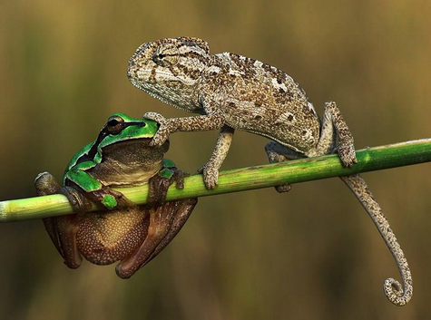
Questions?
@Merrion

Slide 17
Code and architecture recap
Event Grid function triggers
Query orchestration
Command orchestration
Fan-out
Event streams and projections
https://github.com/MerrionComputing/EventsSourcing-on-Azure-Functions
https://github.com/MerrionComputing/AzureFunctions-TheLongRun-Leagues
Notes:
Event Grid for the reliable messaging between domains (and with the outside world) – this allows us to stitch together domains with publish-subscribe, which means we can easily extend the system.
Serverless function hosting for dynamic scaling.
Durable Function Orchestration for the long running processes that handle the commands and queries.
Durable functions fan out/fan in for processes that can run in parallel.
Azure AppendBlob storage to store the data at rest in event streams.

